Slide 1
New conditions for agriculture due to climate change
Bengt Jonsson
Jordbruksverket
Presentation på 5th Nordic Conference on Climate Change Adaptation
Norrköping 23-25 oktober 2018

Slide 2
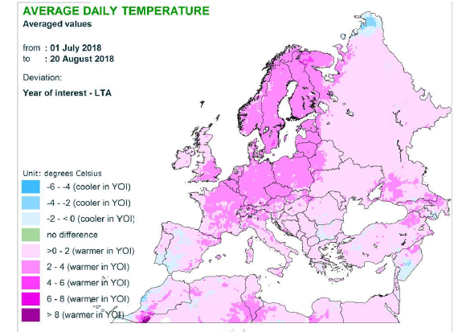
Warmer than normal

Slide 3
Drier than normal

Slide 4
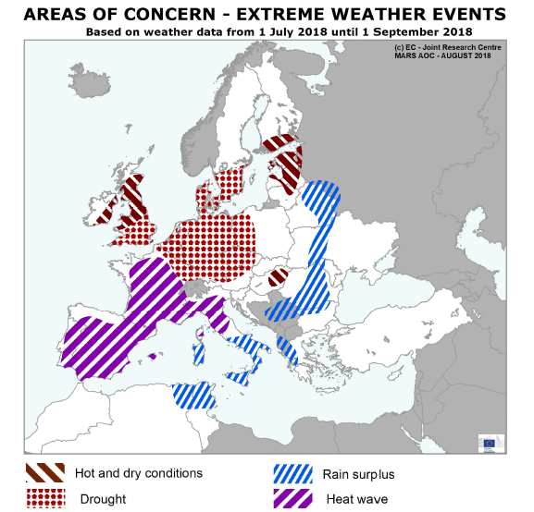
The weather of summer has affected large areas negatively

Slide 5
Experiences from the summer of 2018
In the short term, great stress for both the individual farmer and the whole sector Harvest loss of 30-40 percent for most crops Increased costs and reduced revenues of almost 10 billion SEK There are also more long-term effects

Slide 6
Measures in the CAP to make Swedish agriculture more sustainable
Within the CAP, at least 30 percent of the measures in the PII should be used for environmental and climate measures The climate measures have so far had a relatively small part of the rural program Renewable energy production has been a difficult measure

Slide 7
Climate measures in CAP (PII), %

Slide 8
Need for new measures in CAP 2021-2027
Eco-scheme, measures in PI
Risk management program

Slide 9
Ongoing work in Swedish Board of agriculture
Report to Government march 2019
Identify long-term consequences
Suggest measures that increase resilience
Prepare next CAP-program

